Slide 1



Finding the Missing Persons Using AI

Slide 2
content
Project objectives
Pre-requisites
Project flow
Screenshots
Prior knowledge- data set collection
image preprocessing
model building
video analysis
Result

Slide 3
Project objectives
Preprocessing of the images.
Applying CNN algorithm on the dataset.
Create own dataset
Using deep neural networks used to detect faces
Finding the accuracy of the model
Building web applications

Slide 4
Pre-requisites
Anaconda Navigator: is a free and open-source distribution of the Python and R programming languages for data science and machine learning related applications
Tensor flow: TensorFlow is an end-to-end open-source platform for machine learning. It has a comprehensive, flexible ecosystem of tools, libraries, and community resources that lets researchers push the state-of-the-art in ML and developers can easily build and deploy ML-powered applications.
Keras: Keras leverages various optimization techniques to make high-level neural network API easier and more performant. I
Flask: : Web framework used for building Web applications

Slide 5
Prior knowledge
We need to have minimum basic knowledge on
1.Supervised and unsupervised learning
2.Regression classification and clustering
3.Artificial neural networks
4.Convolution neural networks
5.Working with flask
Requirements

Slide 6
Project flow
The steps to be followed while developing the project are:
User interacts with a web camera to read the video.
Once model analyses the input image from the video frame, when the missing person is detected, triggers an alert message to the Police/Family Members.
To accomplish this, we have to complete all the activities and tasks listed below

Slide 7
Data collection
We need to Collect the dataset or create the dataset.

Slide 8
Image Preprocessing.
Import ImageDataGenerator Library.
Define the parameters /arguments for ImageDataGenerator class
Applying ImageDataGenerator functionality to trainset and testset.

Slide 9
MODEL BUILDING
Import the model building Libraries
Initializing the model
Adding CNN Layers
Adding Hidden Layer
Adding Output Layer
Configure the Learning Process
Training and testing the model
Optimise the Model
Save the Model

Slide 10
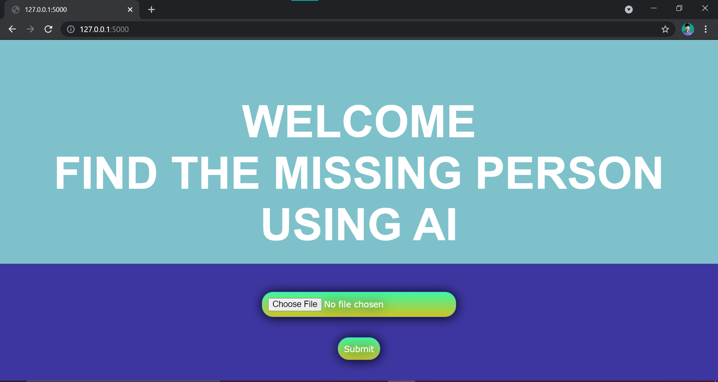
SCREENSHOTS

Slide 11
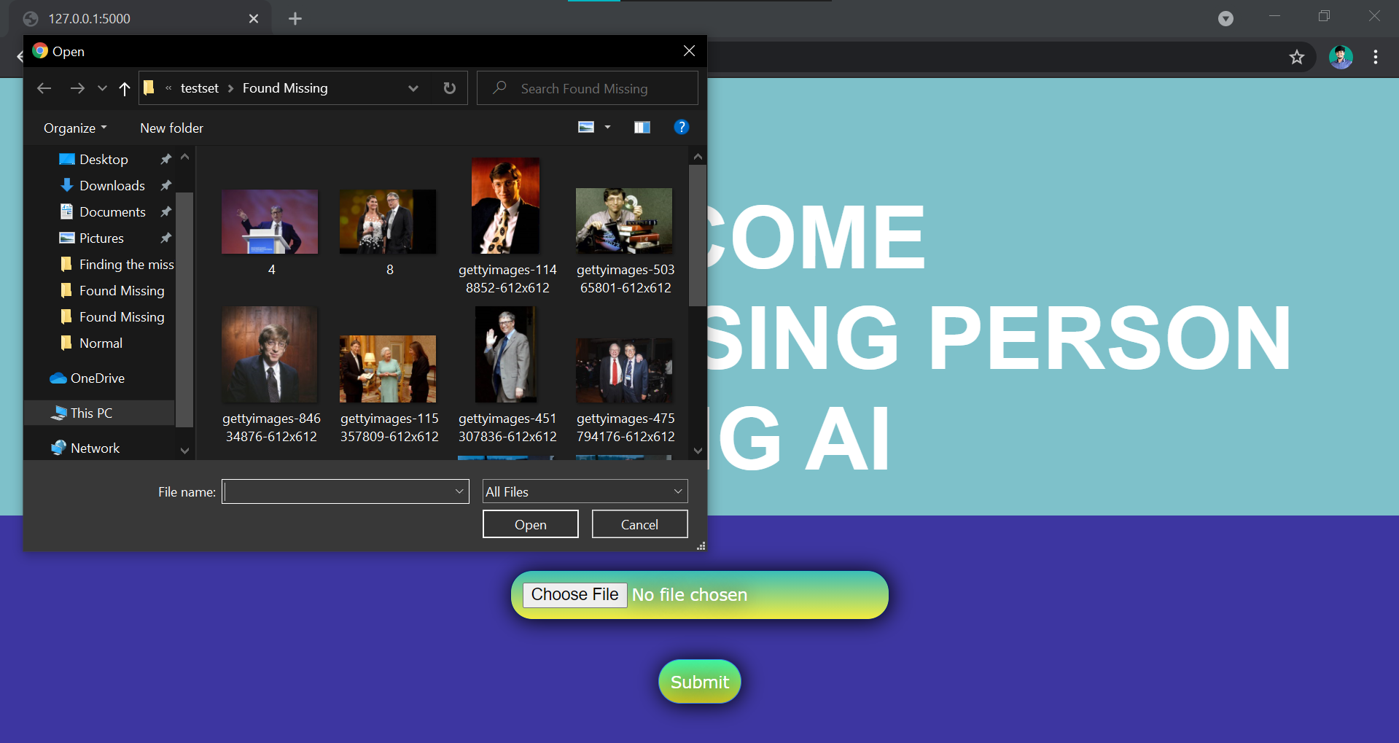
SCREENSHOTS

Slide 12
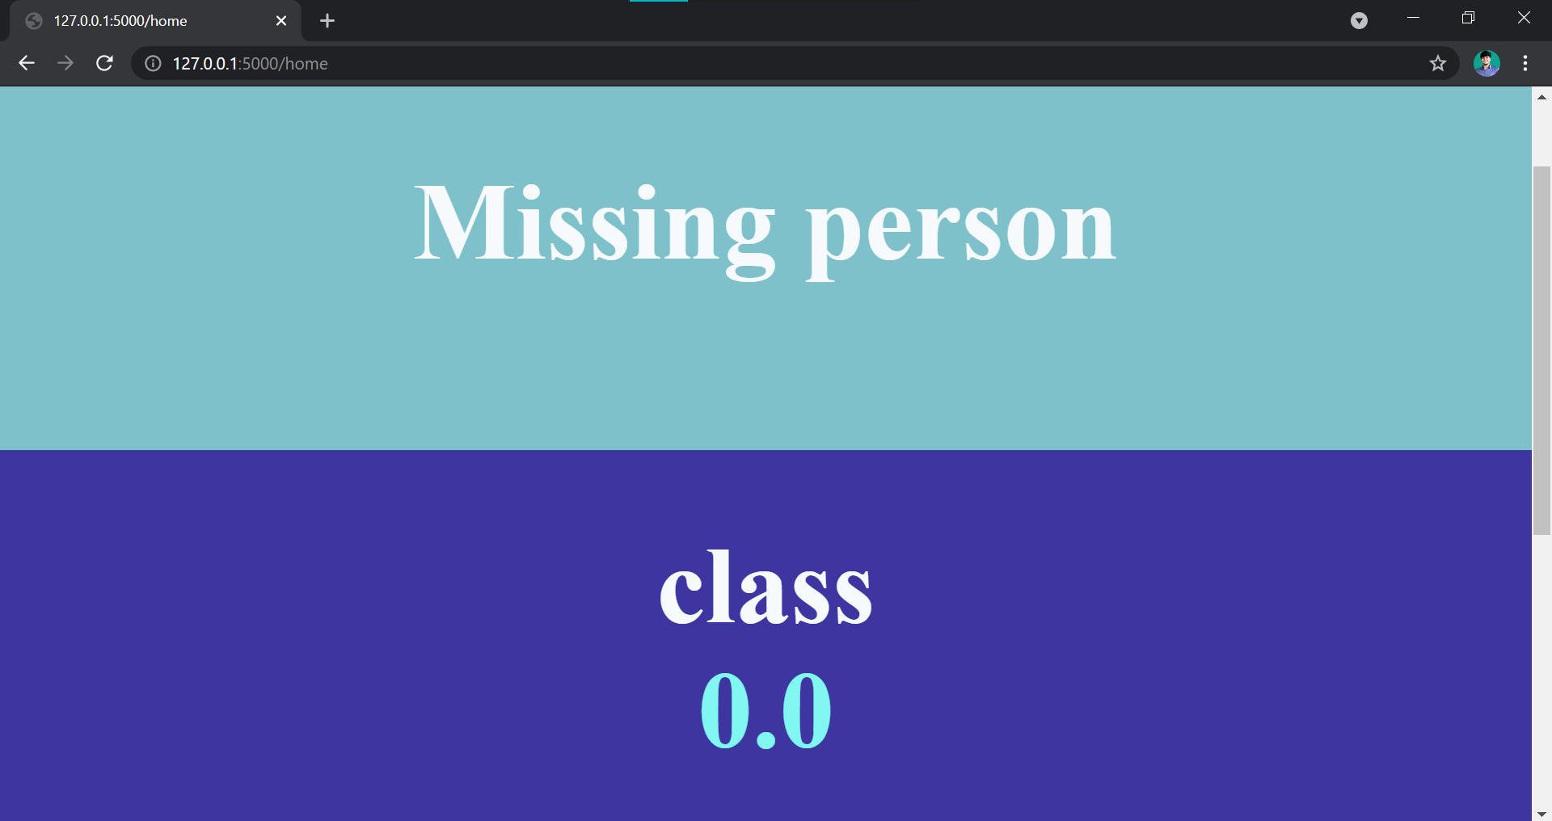
SCREENSHOTS

Slide 13
Video presentation
link

Slide 14

THANK YOU

